Slide 1
Characteristics of pinned polymer loop in external field
Wenwen Huang
13.04.2015
For PhD seminar

Slide 2
Outline
Background Reminder
Results
TODO

Slide 3
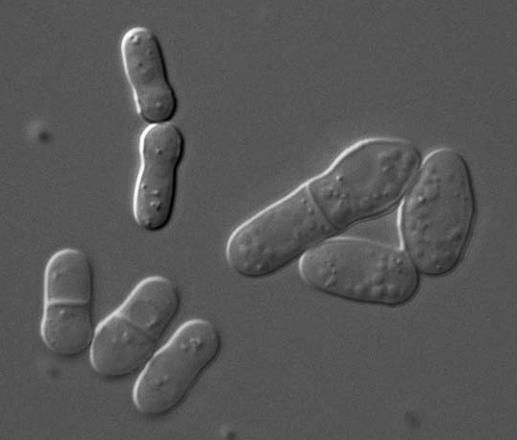

Fission Yeast( S. pombe)
Sketch of fission yeast
during cell division
Rhind N et al. Science. April 21, 2011

Slide 4
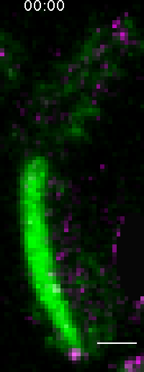
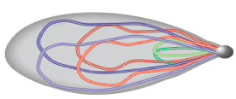
Chromosome Movement ( S. pombe)
3 pairs of chromosomes
Telomere bond to SPB
Oscillation is driven by SPB
In the mean time:
Homologous chromosomes
paring and recombination
Chikashige et al., Science 1994
Yamamoto et al, JCB 1999
Ding et al., DevCell 2004

Slide 5
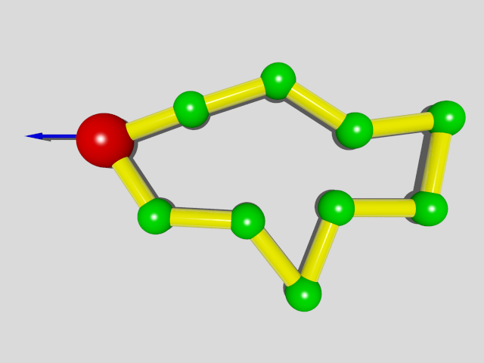
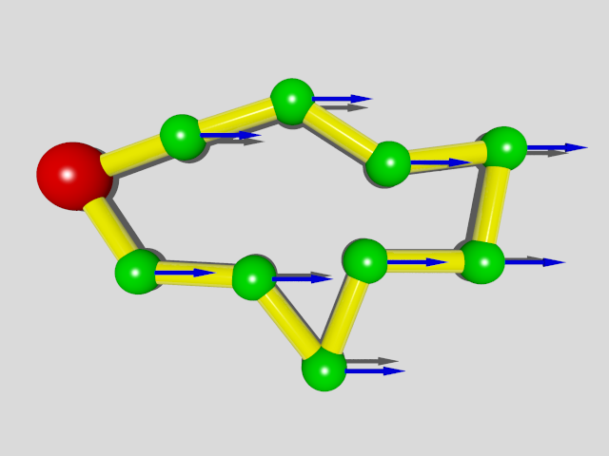
Polymer Ring
One Chromosome is represented by a polymer ring with the driven bead be the SPB(spindle pole body).
co-moving frame

Slide 6
Freely Joined Bead-Rod Ring
Bead:
position ----
Rod:
length ---
Results we already have:
Mean position:
Position Variance:

Slide 7
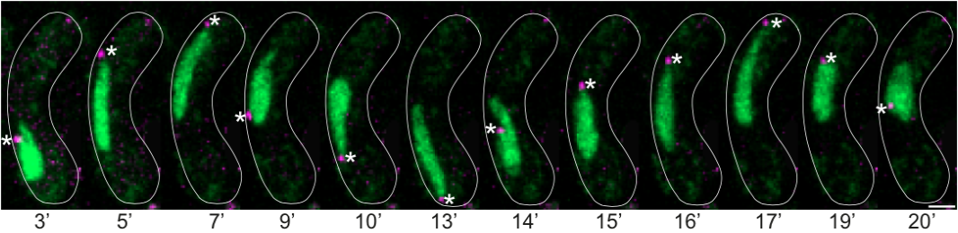
Shape of chromosomes in nucleus
Fluid nuclear membrane
Spindle Pole Body
Chromosomes in nucleus

Slide 8
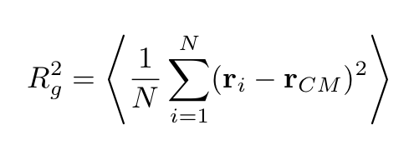
Characteristic quantities
Gyration radius:
Gyration tensor:

Slide 9
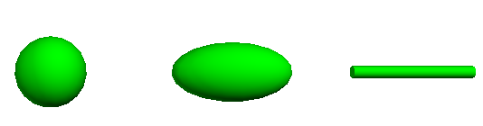
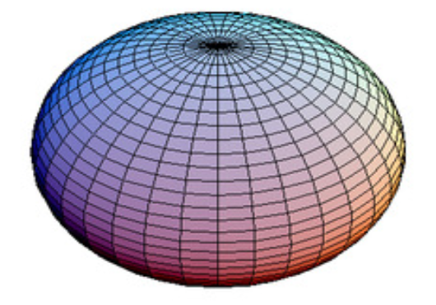
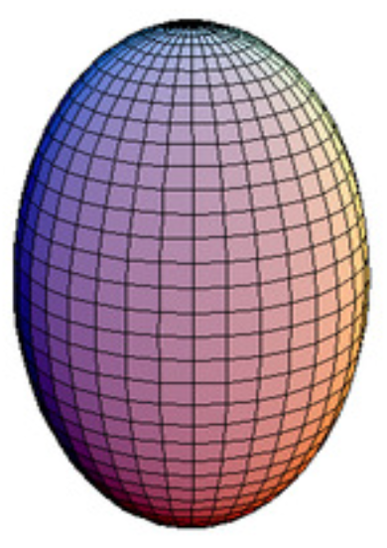
Asphericity & the nature of asphericity
Asphericity:
0
1
the nature of asphericity:
-1
+1
J. W. Cannon, J. Phys. (1991)
Karen Alim & Erwin Frey, PRL (2007)

Slide 10
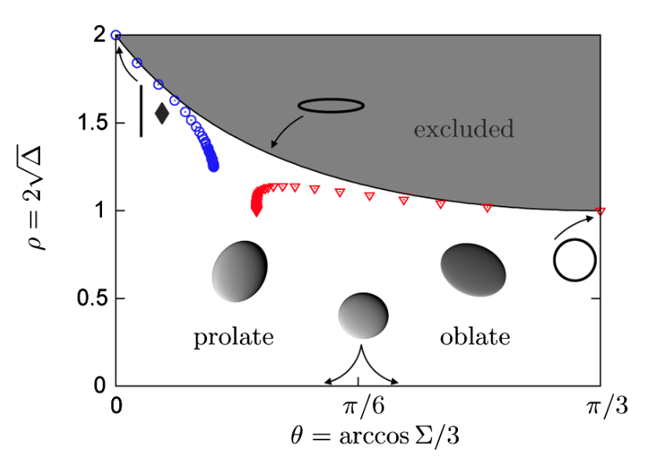
Asphericity & the nature of asphericity
Karen Alim & Erwin Frey, PRL (2007),

Slide 11
Gyration Radius (N=100)

Slide 12
Gyration Radius (N=100)
Notes:
----- Meeting Notes (13/04/15 10:54) -----
check gaussian ring limit

Slide 13
Asphericity & the nature of asphericity (N=100)
Notes:
----- Meeting Notes (13/04/15 10:54) -----
average order

Slide 14
Asphericity & the nature of asphericity (N=100)

Slide 15
Asphericity & the nature of asphericity

Slide 16
Gyration Radius (N=100, with volumn)

Slide 17
Asphericity & the nature of asphericity (N=100)

Slide 18
Asphericity & the nature of asphericity

Slide 19
Gyration Radius (multiple rings)

Slide 20
Asphericity & the nature of asphericity (N=100)

Slide 21
Asphericity & the nature of asphericity

Slide 22
All suggestions and comments
are greatly appreciated!
Thank you!

Slide 23
Bead-Rod Ring Model
A Chromosome is represented by a bead-rod ring with
the driven bead be the SPB(spindle pole body).
Ring driven by a Constant force
Bead:
position ----
Rod:
length ---

Slide 24
Theory for 1D model
Transfer to co-moving frame:
Constant driven force on SPB
Constant force field and pinned SPB
For 1D system:
Loop Constraint:

Slide 25
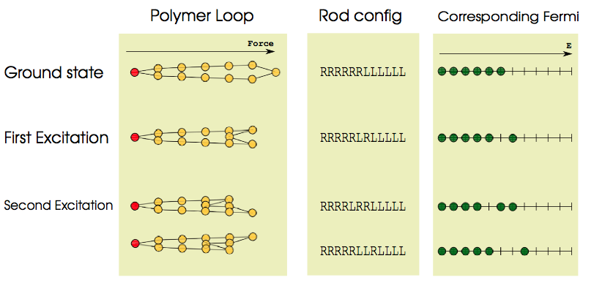
Theory for 1D model
Hamiltonian:
Equivalent to N/2 Fermions in N energy levels

Slide 26
Theory for 1D model
Partition function
By setting natural temperature unit
Fermi-Dirac distribution
Statistical Results

Slide 27
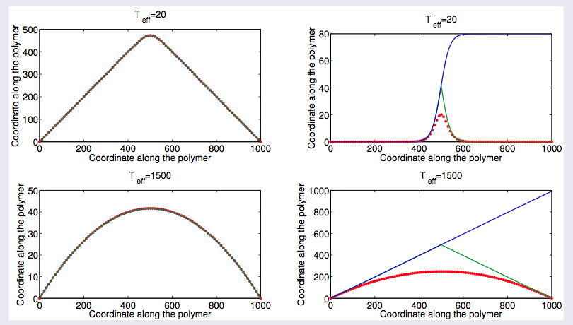
1D Theory

Slide 28
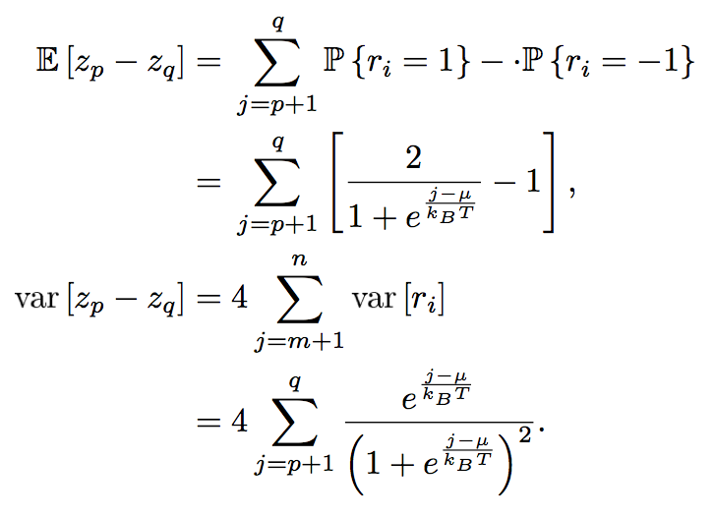
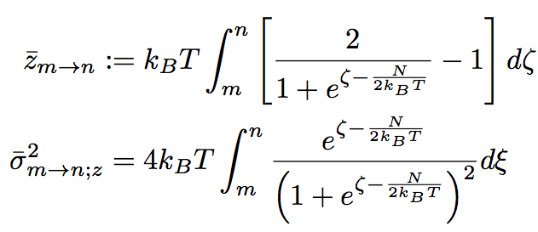
Brownian Bridge Approach
--- devise an effective stochastic process satisfies Z_{N}= Z₀
Step 1: construct effective process:
Z₀ = 0;
Z_{l} is almost surely continuous;
Z_{l} has independent increments;
Where the mean and the variance is determined by:

Slide 29
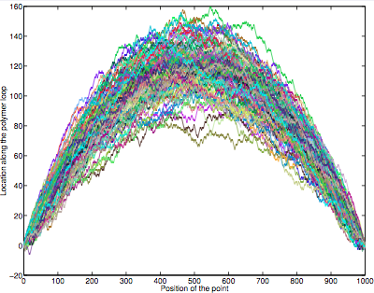
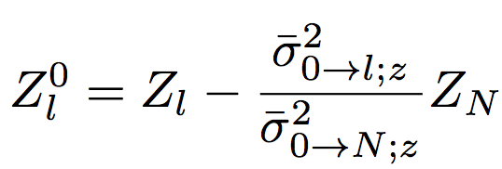
Brownian Bridge Approach
--- devise an effective stochastic process satisfies Z_{N}= Z₀
Step 2: introduce loop condition
Construct conditional process:
where

Slide 30
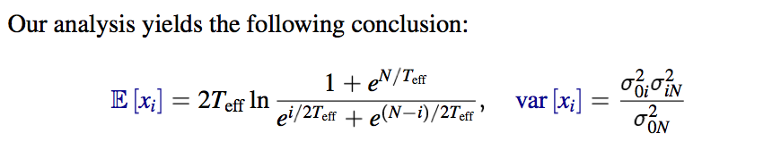
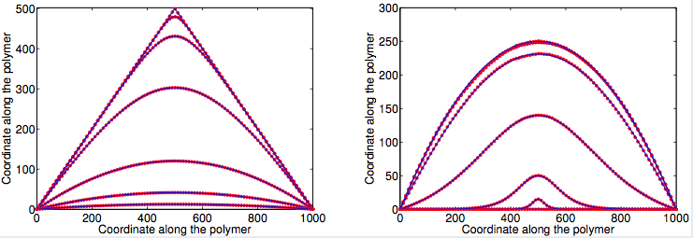
Numerical Verification of 1D model

Slide 31
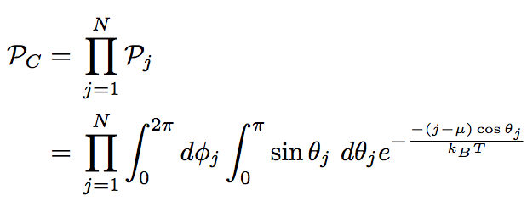
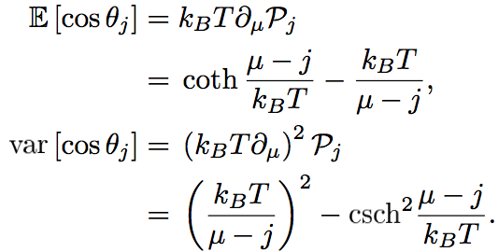
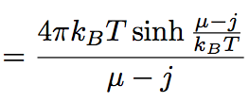
3D Continuous Model
Hamiltonian
Heisenberg model
Partition function

Slide 32
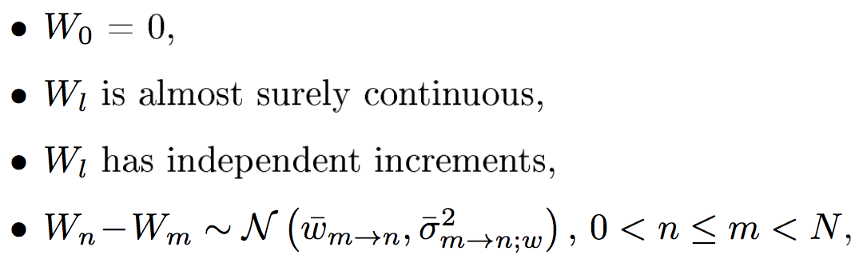
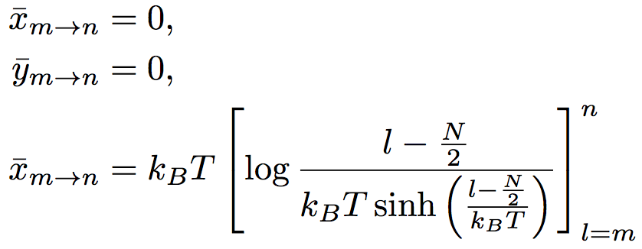
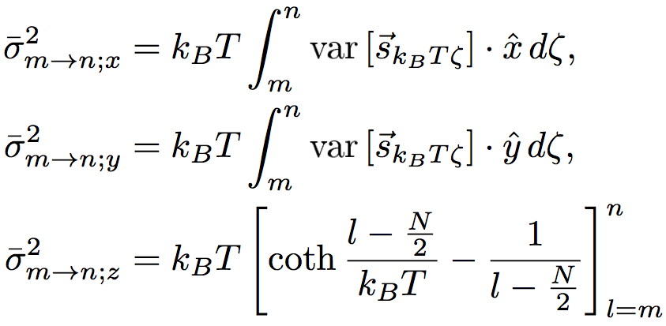
Adopt Brownian Bridge Approach
Define Effective 3D stochastic process:
Conditional effective process:

Slide 33
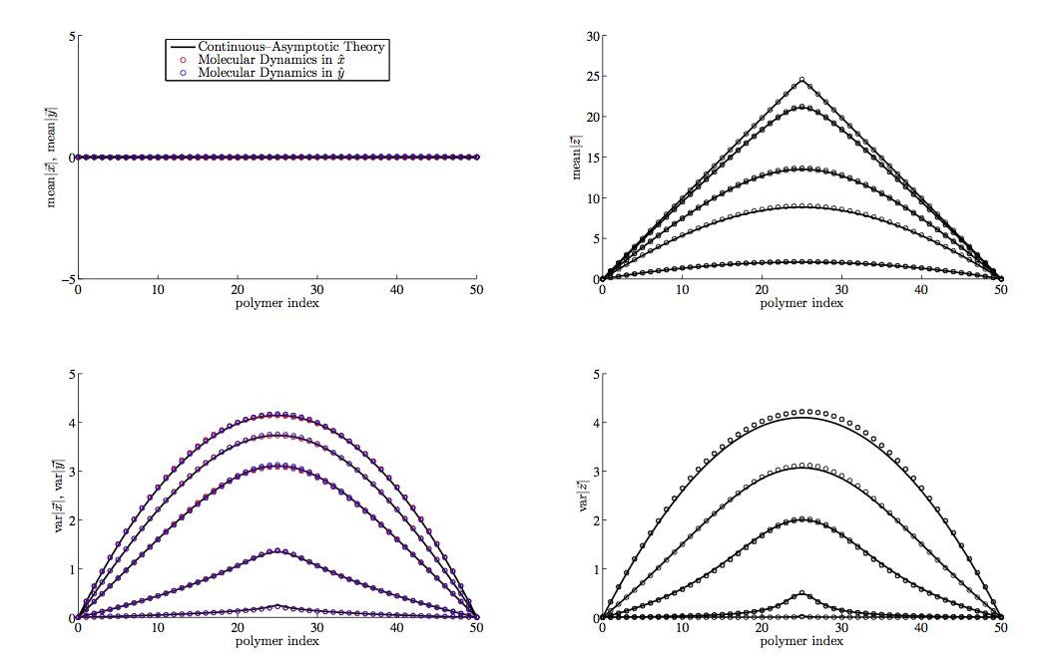
Numerical Verification of 3D model

Slide 34
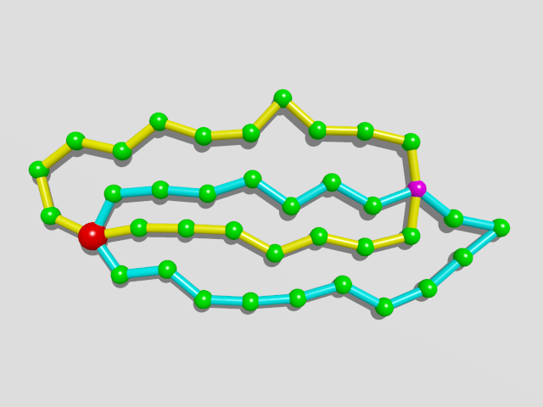
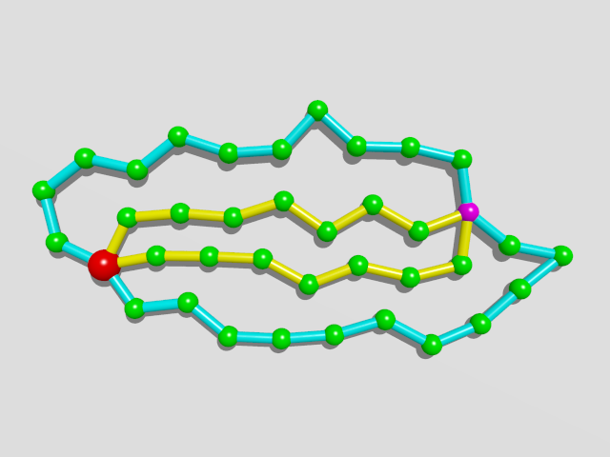
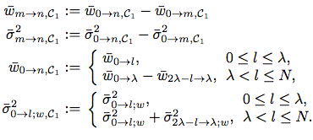
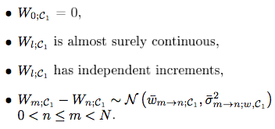
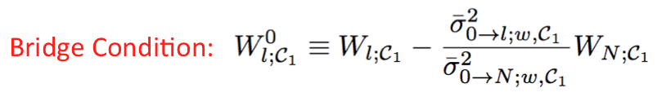
A Pair of Rings with Centromere
Re-label the loops
Brownian Bridge

Slide 35
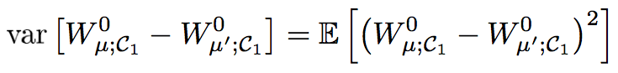
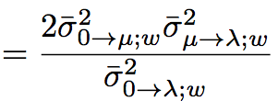
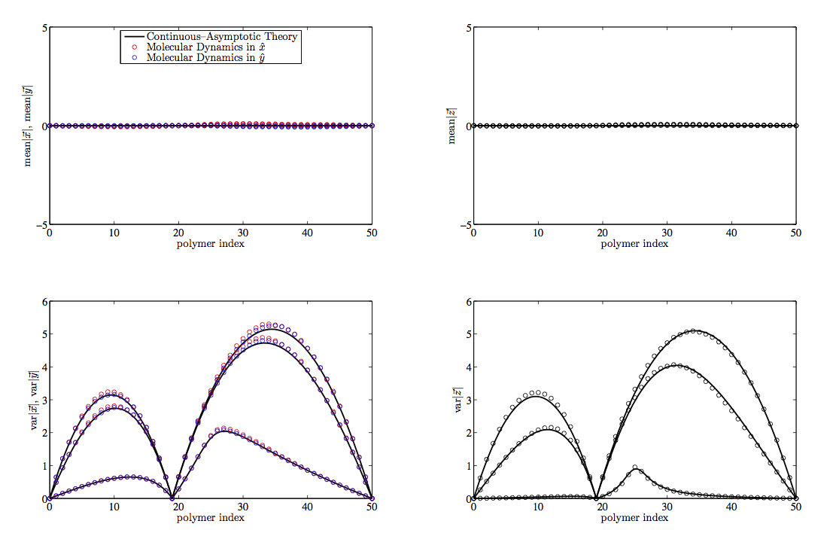
Numerical Verification
Theoretical Result

Slide 36
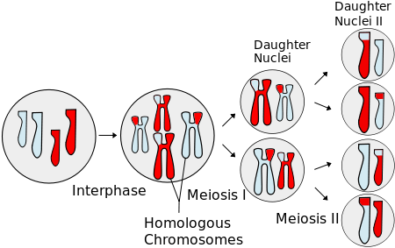
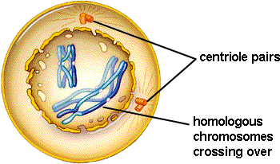
Meiosis
Prophase I
Chromosome movements
Pairing
Recombination

Slide 37
Brownian Dynamics:
Inertia-less assumption
is the index of bead
is hydrodynamic force
represents force generate from potential
is constraint force to keep the rod length
is brownian force
is external force

Slide 38
Brownian Dynamics:
Dynamical differential equation:

Slide 39
Numerical Scheme
Predictor-corrector algorithm:
Step 1: predict using known forces
Step 2: correct using constraint force
(*)
Step 3: substitute eq. (*) to constraint equations
Solve a set of nonlinear algebraic equations
Step 4: re-substitute to (*) obtain the final

Slide 40
Parameter Estimation
Length of Chromosomes in base pairs:
There are 3 pairs of chromosomes in prophase fission yeast
Chromosome I: 5.579.133 bp ~ 5,6Mbp
Chromosome II: 4.539.804 bp ~ 4,5Mbp
Chromosome III: 2.452.833 bp ~ 2,5Mbp
Compaction ratio of chromosomes: ~ 100bp/nm
Kuhn length(rod length): ~ 100nm
System size for 3 pairs of chromosomes: ~ 2000-3000
monomers in one ring : 200 ~ 600

Slide 41
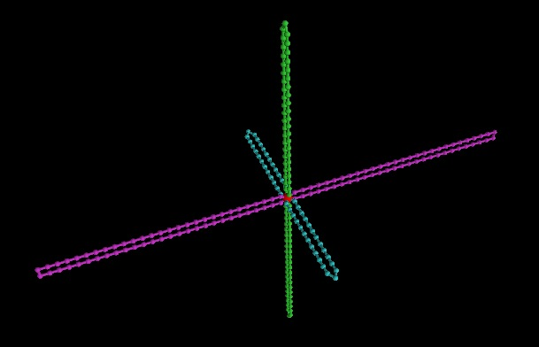
Initial configuration

Slide 42
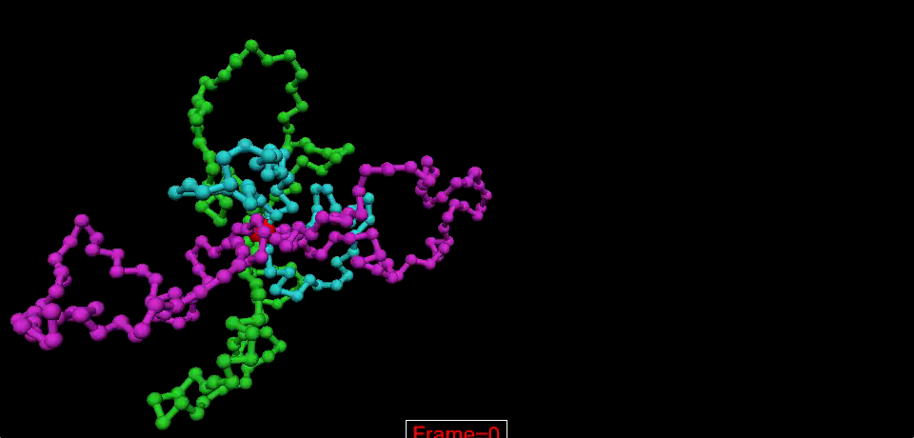
Animation Movie

Slide 43
Problem
Toy model with 100 beads
Real System
Solution:
Parallel computation

Slide 44
Ways to go
Use some kinds of sophisticated MD packages
Advantage:
easier to go, parallelize automatically
Disadvantage:
cannot control some details, e.g. random force
not so flexible
Write a parallel program
Totally under control but need more time on technique details
My Strategy
Doesn’t work
Write a parallel program
Try MD packages

Slide 45
List of MD packages
http://en.wikipedia.org/wiki/List_of_software_for_molecular_mechanics_modeling
Rules of selection
No commercial, should be free
Need GPU acceleration
Widely used
Selected packages:
Gromacs
LAMMPS
ESPResSo

Slide 46
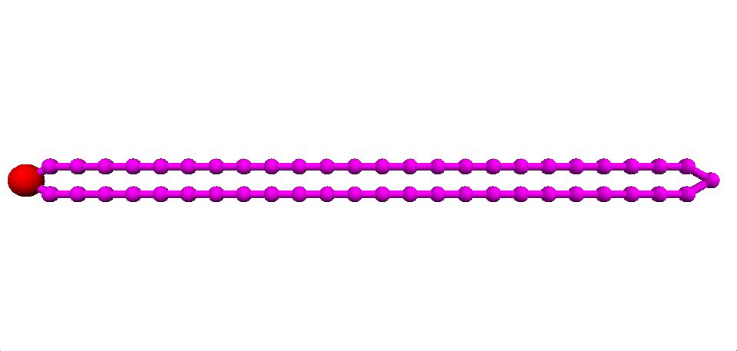
Results (T = 1, N =50)

Slide 47
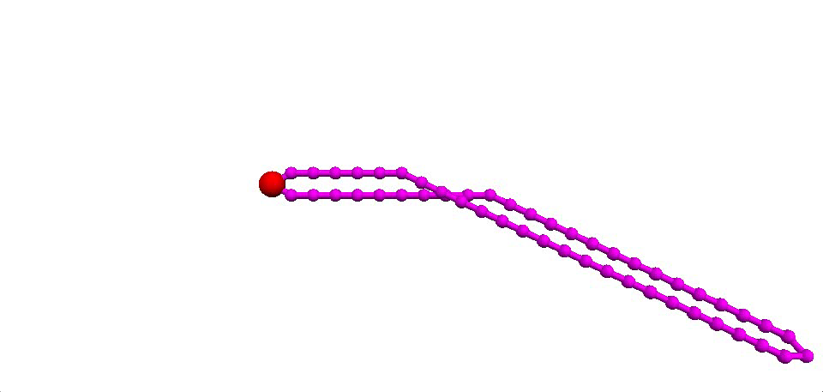
Results (T=10000, N =50)

Slide 48
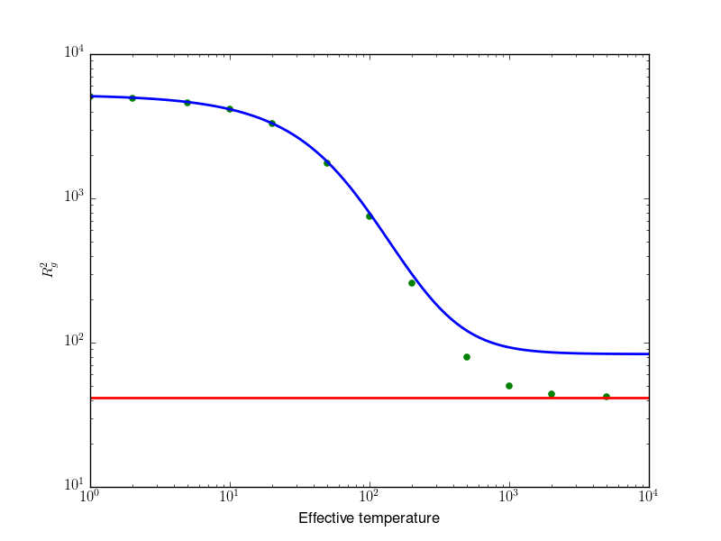
Results (N=500)

Slide 49
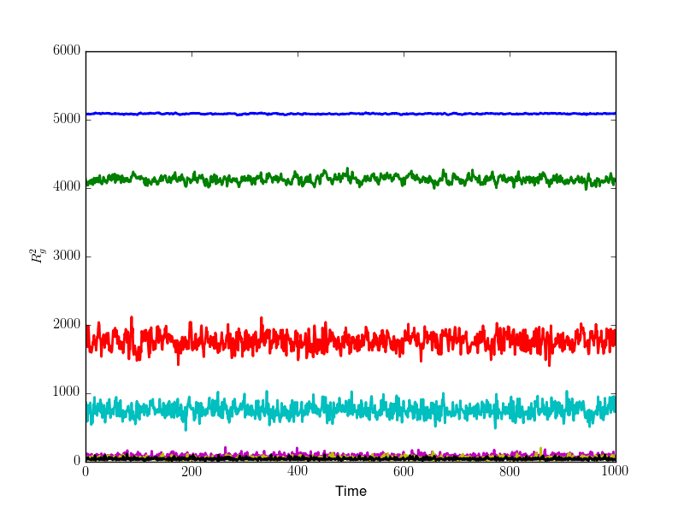
Results (N=500)

Slide 50
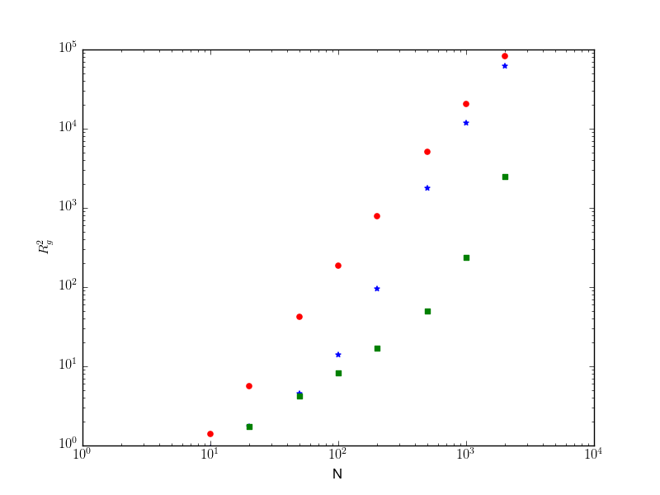
Results (r: T=1, b: T=50, g: T=1000)

Slide 51
TODO
Gyration tensor: both numerically and analytically
Multiple polymer rings ---- Lennard-Jones interaction?
Shape at turning point
?
Tumbling dynamics

Slide 52
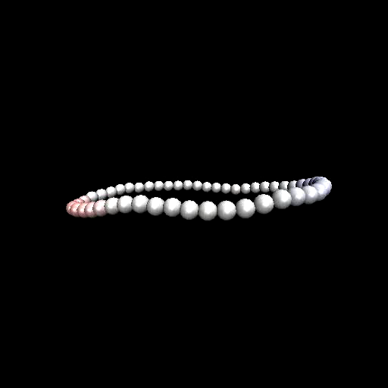
Tumbling dynamics
Philipp S. Lang etal. Phys. Rev. E 89, 022606 (2014)

